Slide 1
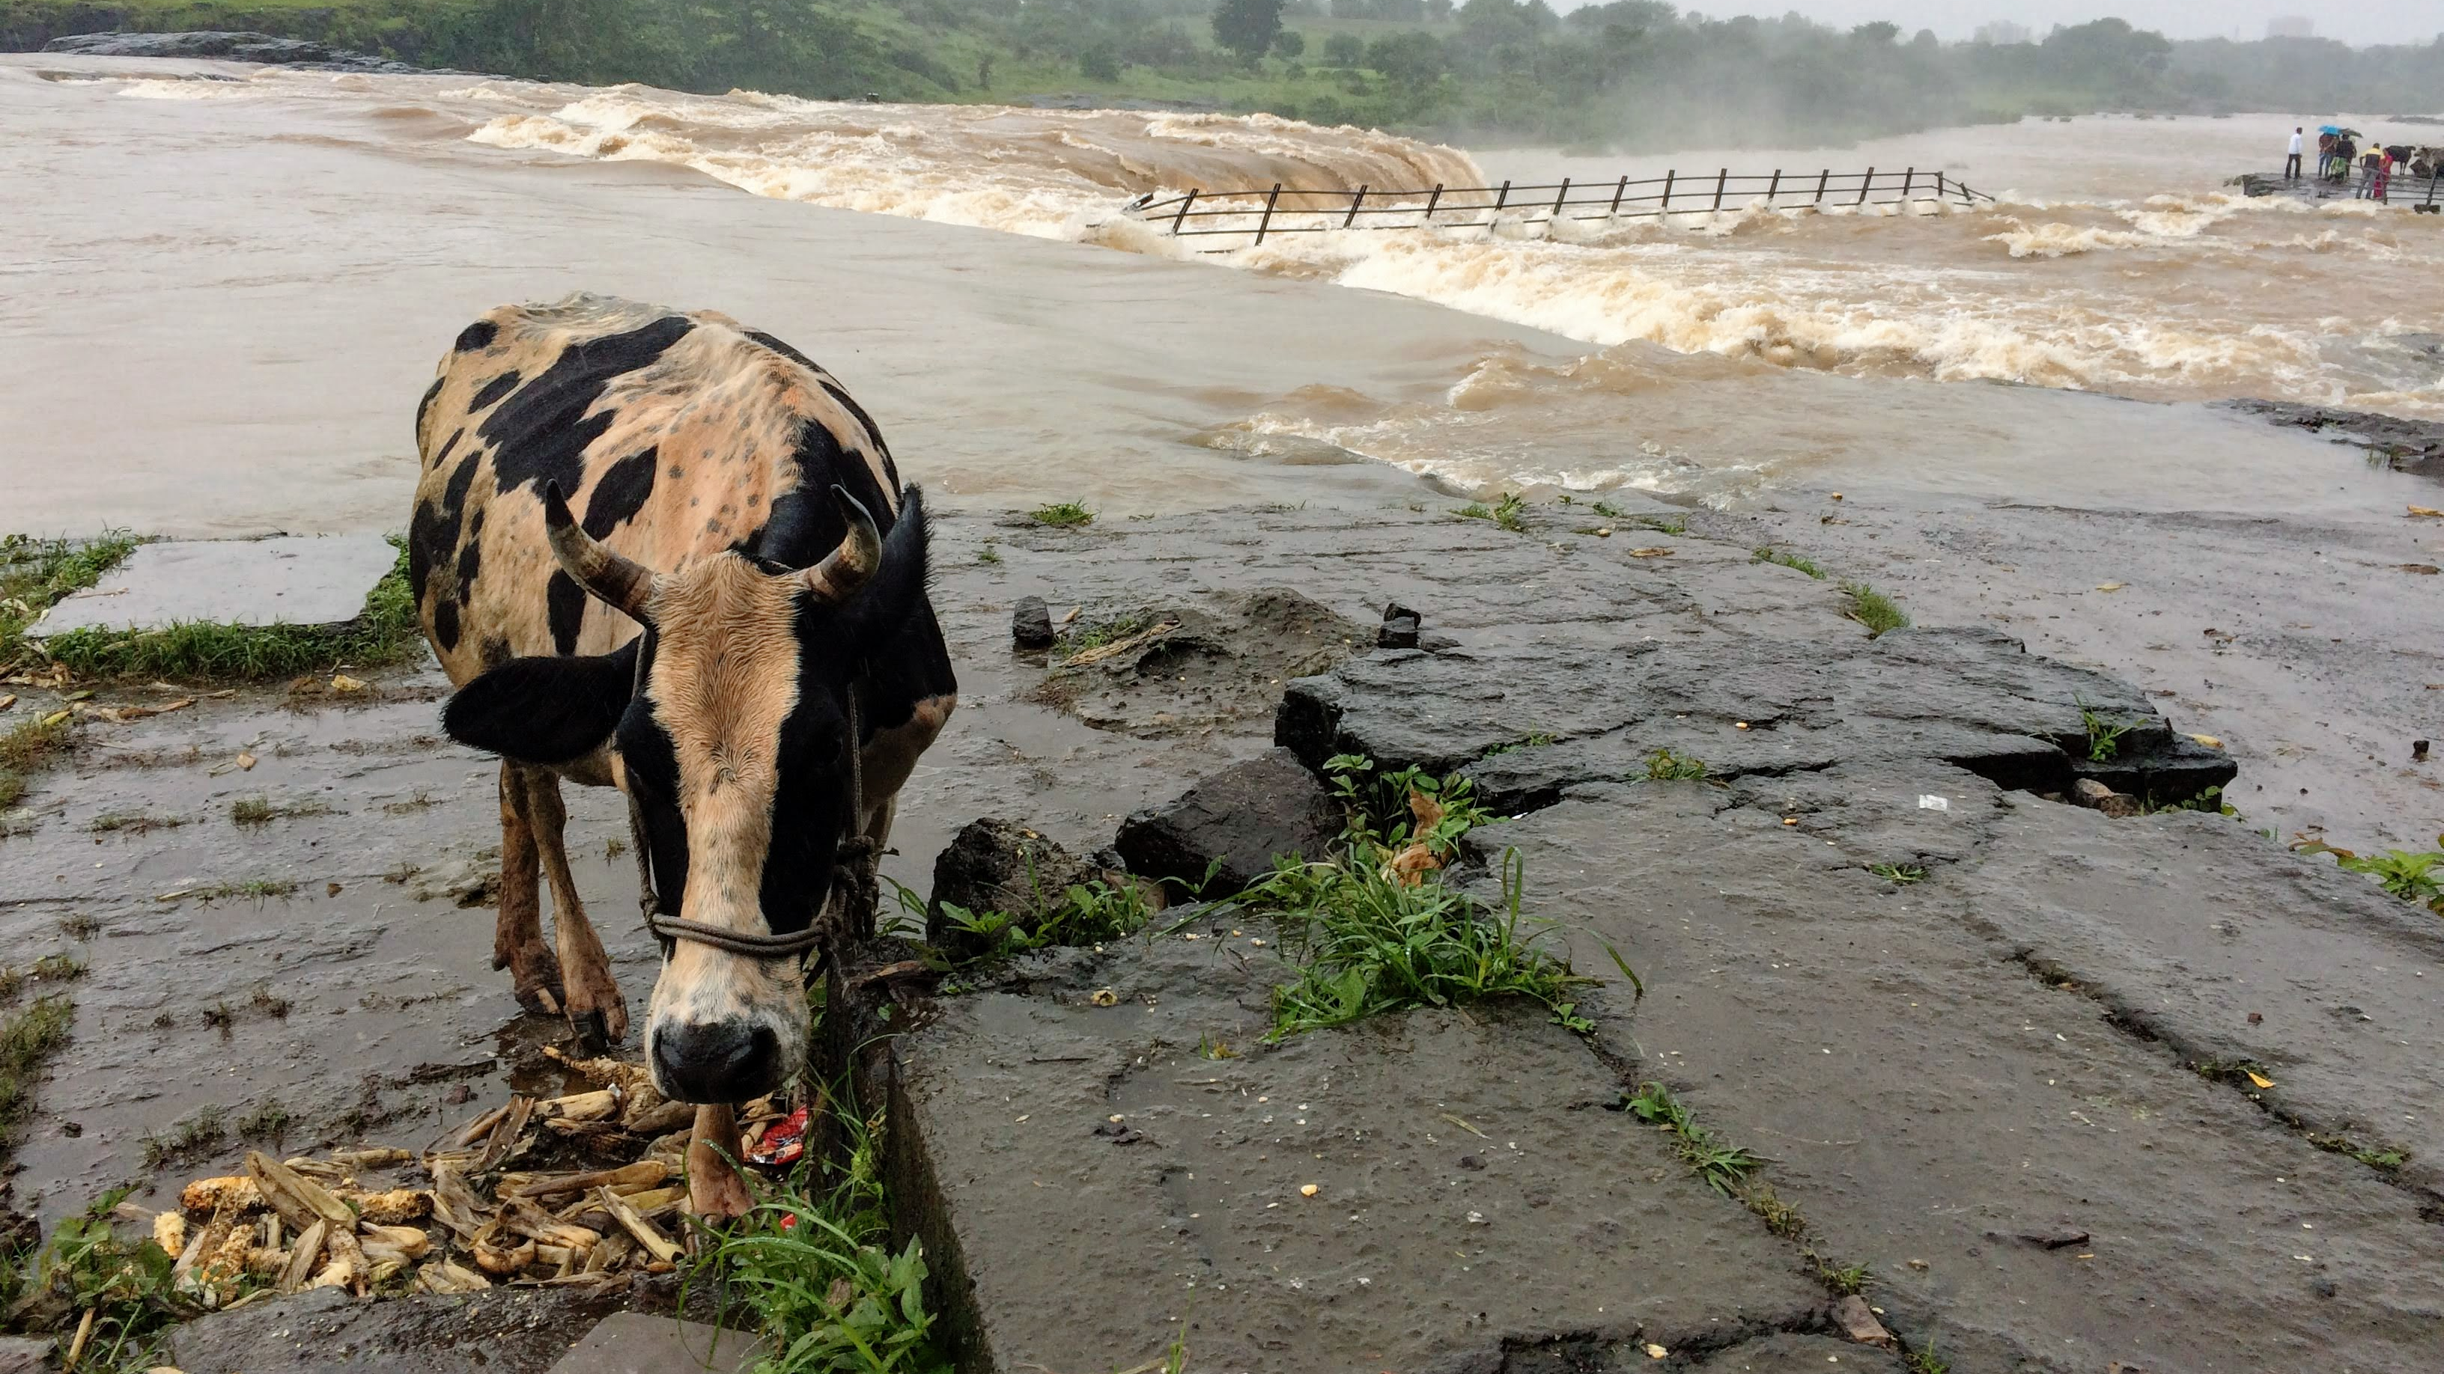
Hydrological
module
Mikhail Smilovic
FUSE team meeting on May 4, 2020

Slide 2
Water balance of a watershed
A water balance is used to understand the different flows through a system.
The inputs to the system should equal the outputs from the system plus whatever changed in the system.
Inputs = Outputs + Storage change

Slide 3
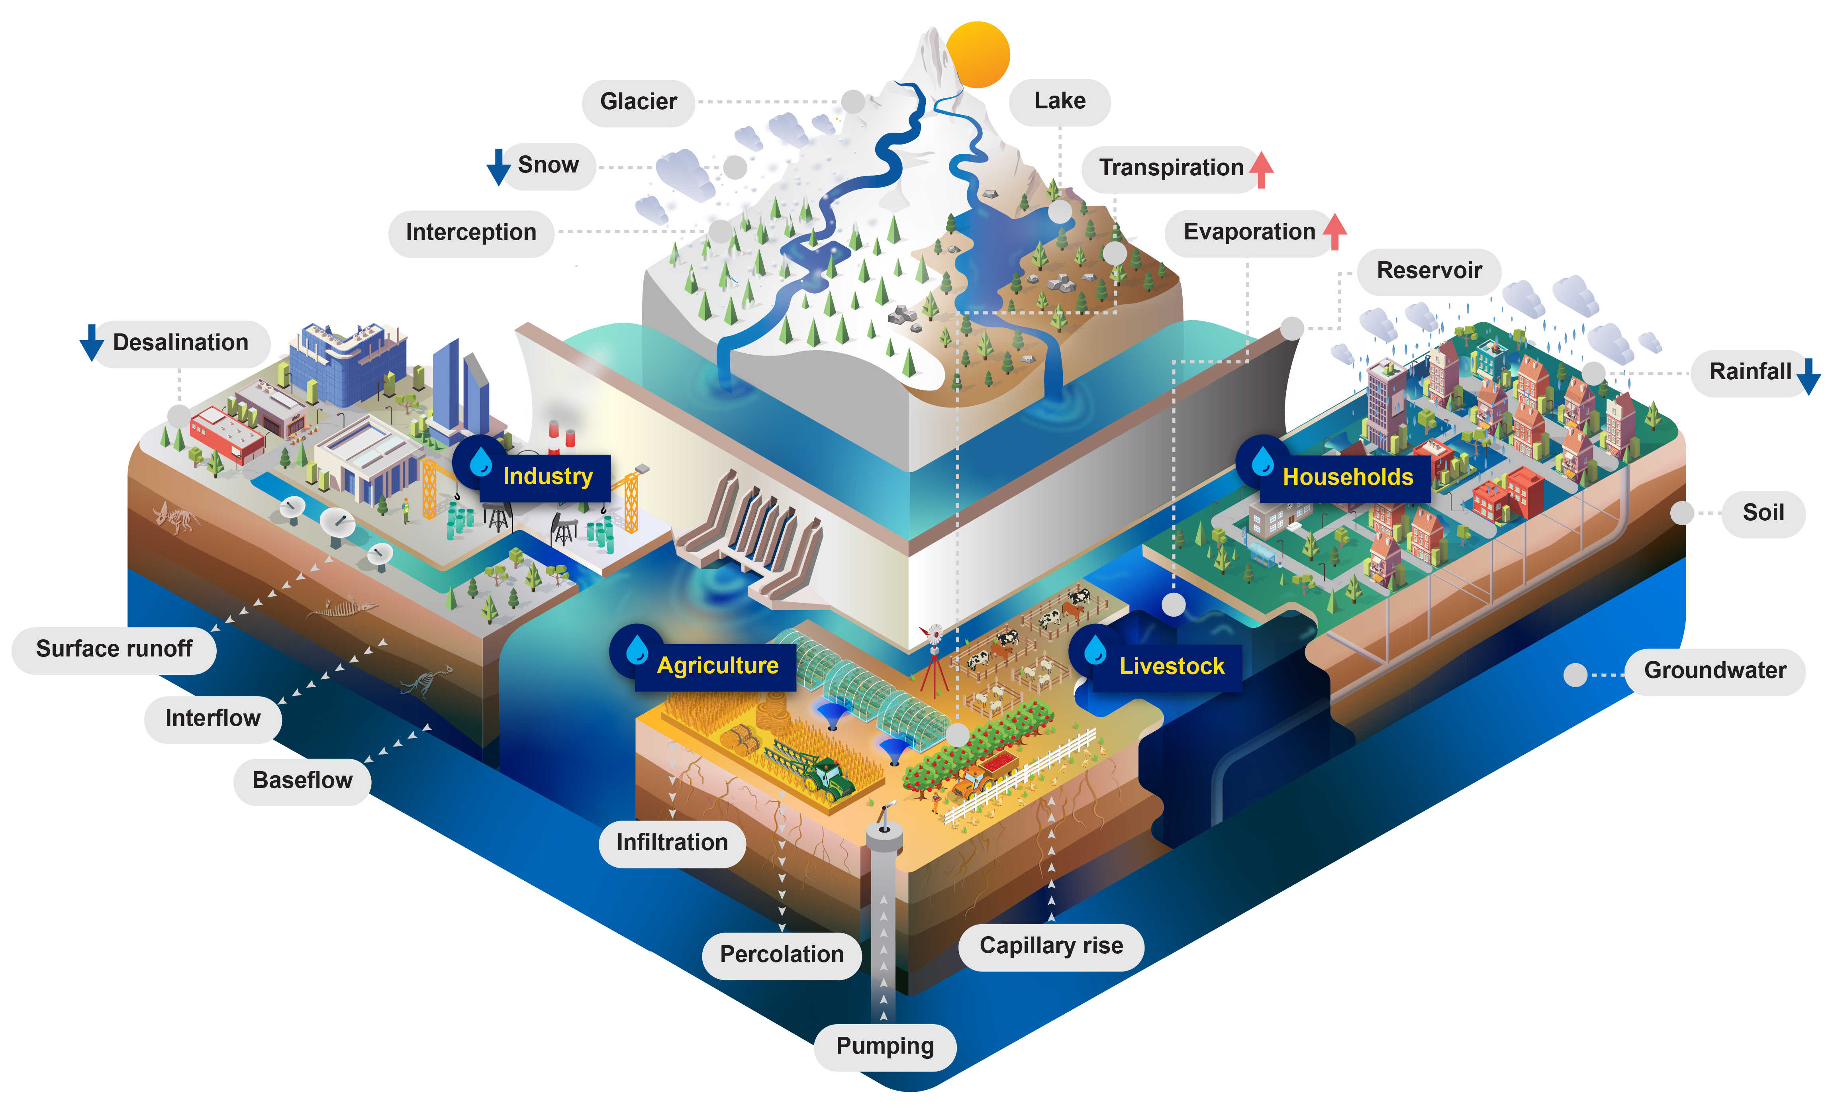
Inputs: How is water entering the watershed?

Slide 4
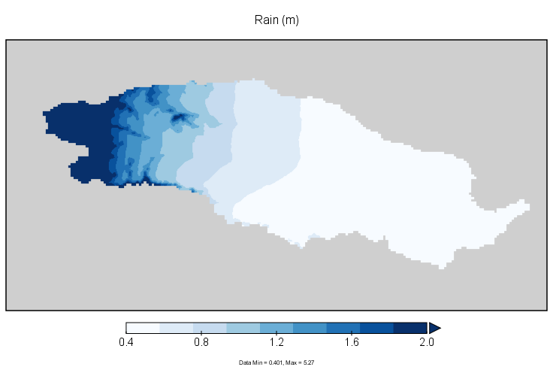
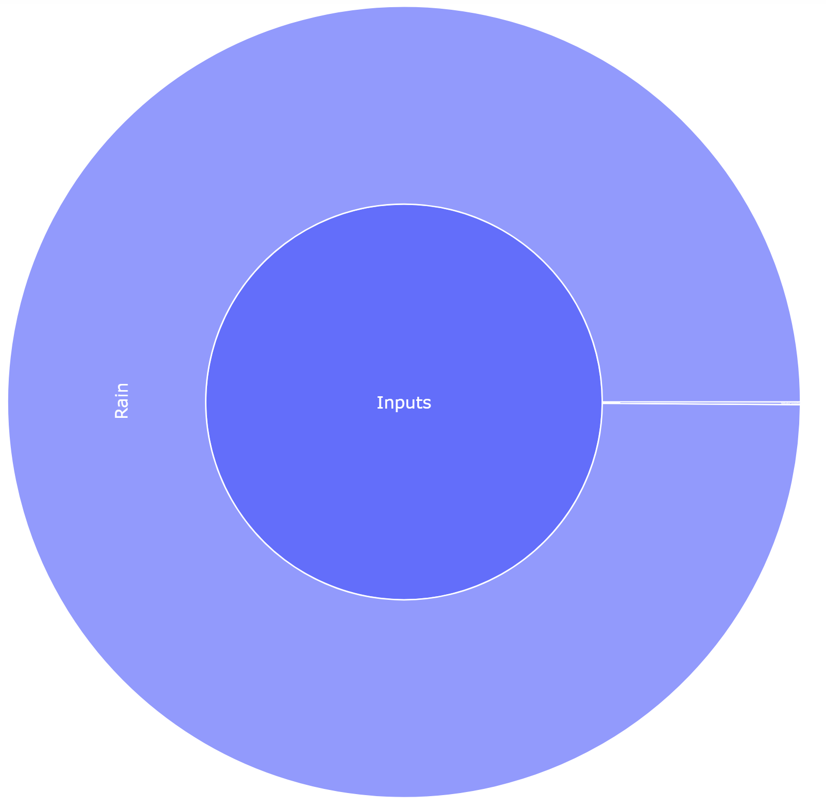
Inputs
Highlight
Rain
INPUTS
Rainfall occurs mainly from June to October, and more towards the west.

Slide 5
Outputs: How is water leaving the watershed?

Slide 6
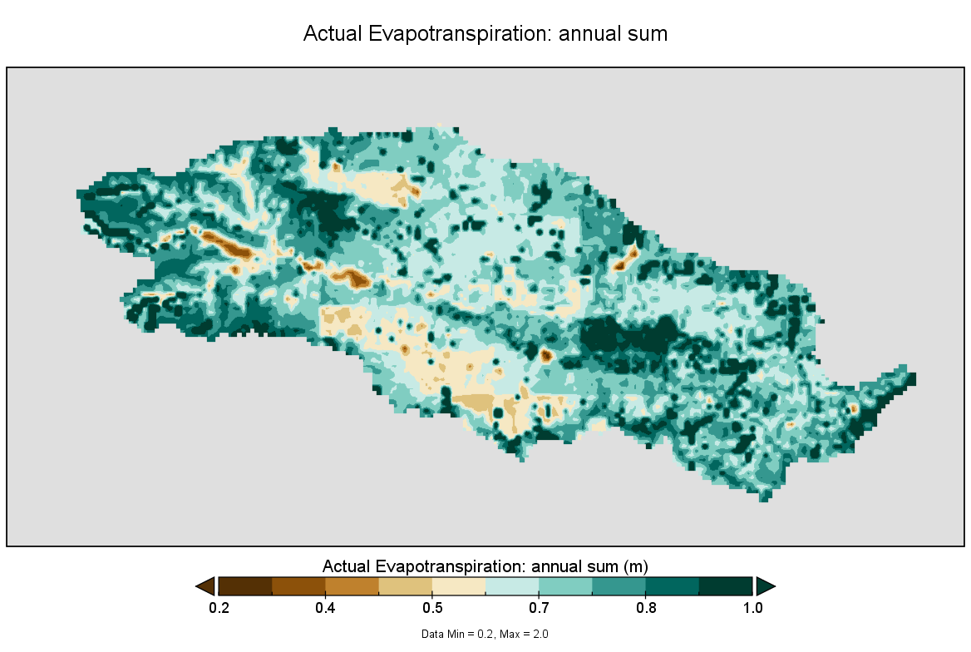
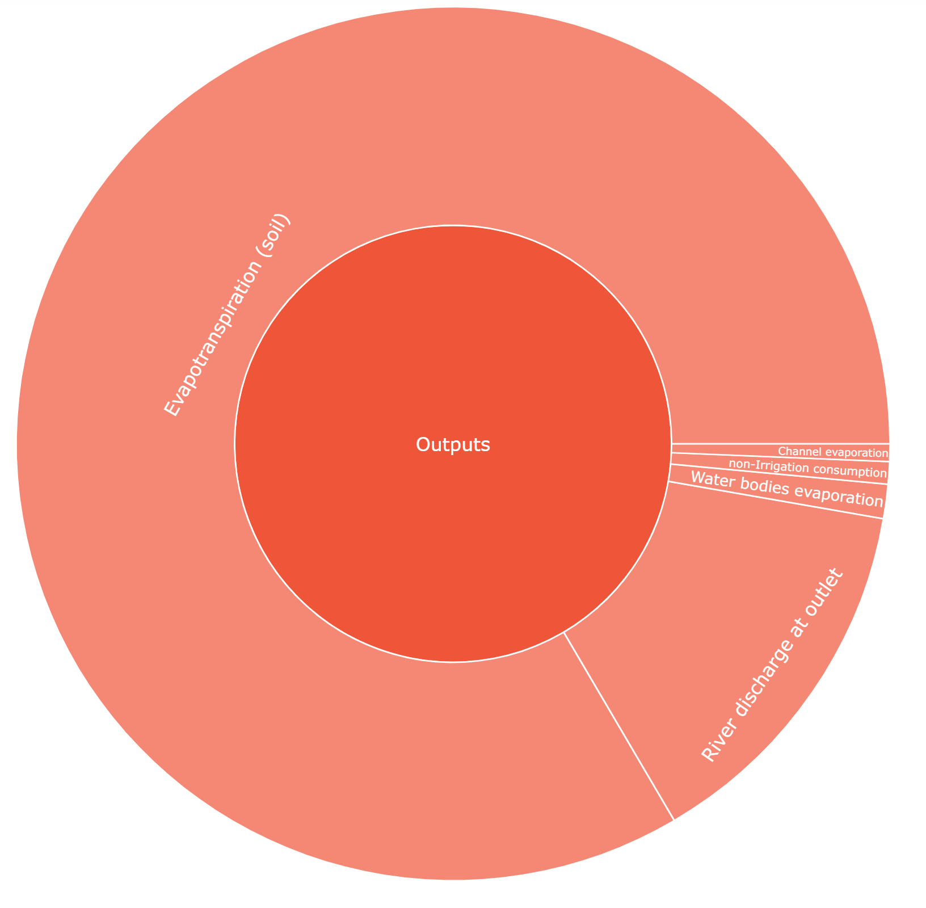
Outputs:
Highlight
Evapotranspiration (land)
Channel evaporation
OUTPUTS
non-Irrigation consumption
River
discharge
Waterbody evaporation
Evapotranspiration on land is the dominant outflow from the watershed.

Slide 7
Storage change

Slide 8
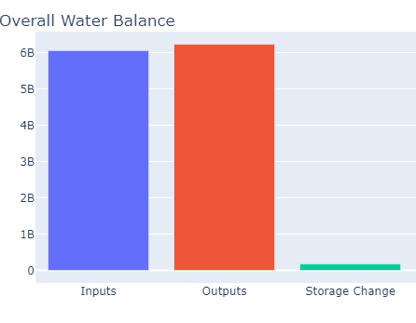
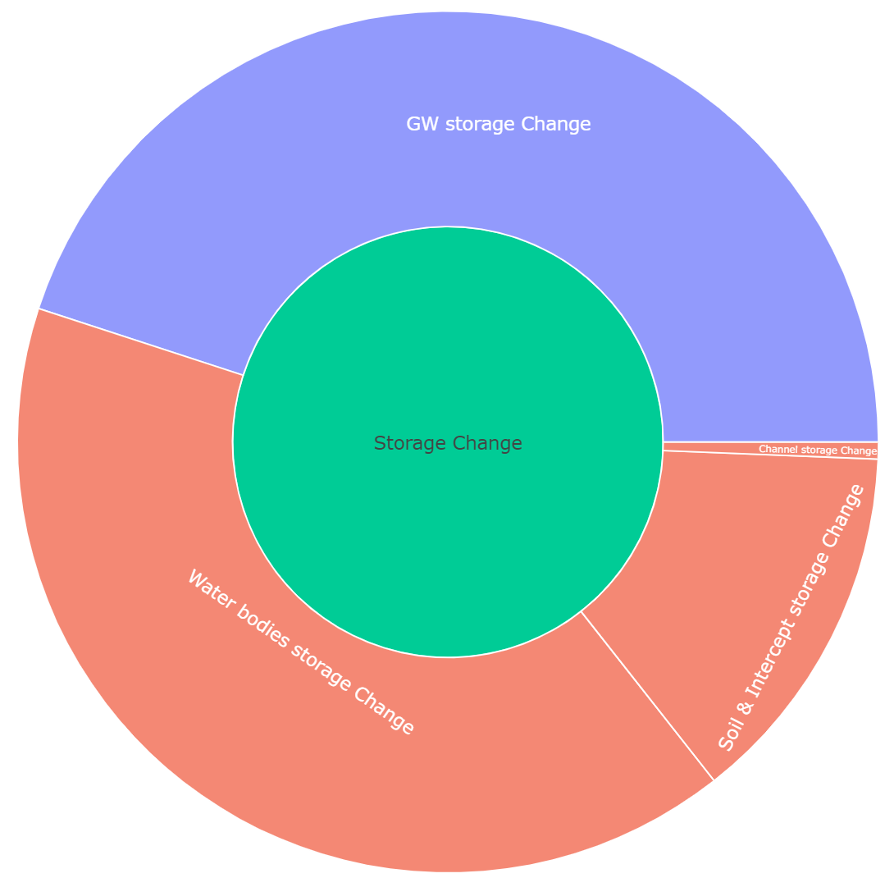
Storage change
Highlight
Blue indicates that storage increased
Groundwater
STORAGE CHANGE
River
Soil
Red indicates that storage decreased
Waterbodies
Storage change is relatively limited from year to year

Slide 9
Flows and Storages

Slide 10
Rain
Evapotranspiration (land)
Groundwater
INPUTS
OUTPUTS
STORAGE CHANGE
River
discharge
Soil
Waterbodies

Slide 11
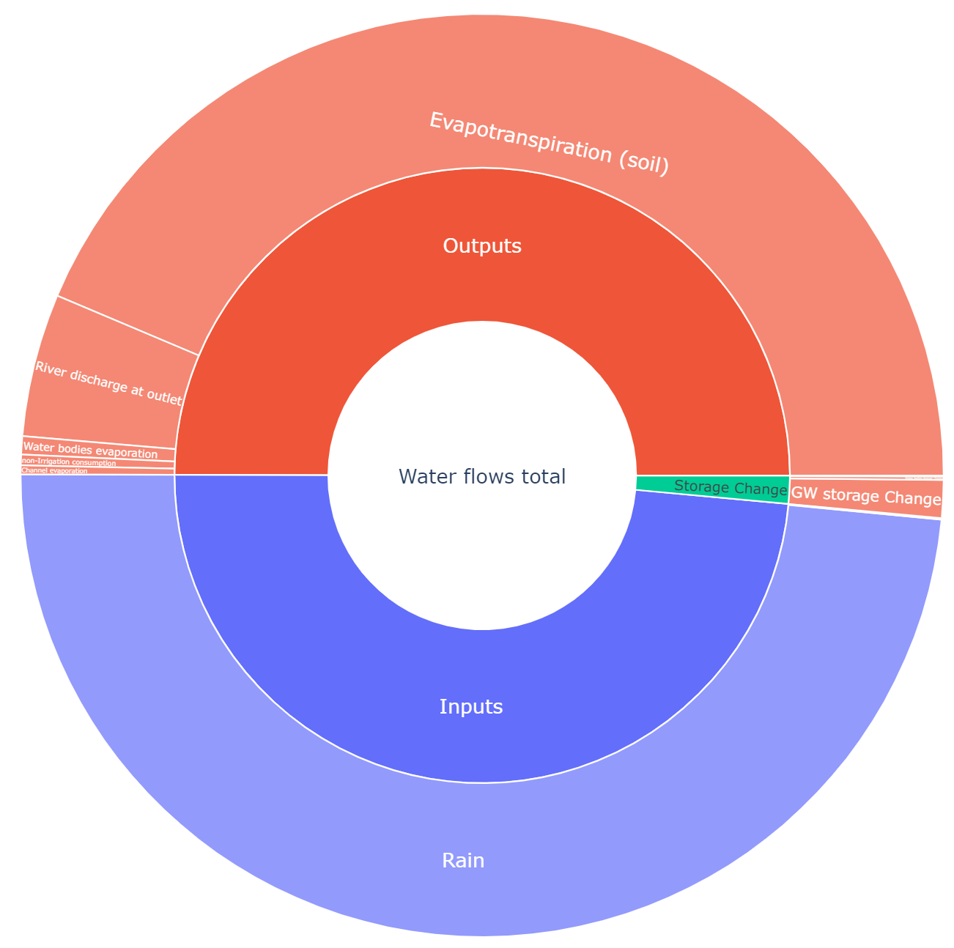
Water balance circle
Evapotranspiration (land)
The water balance is illustrated here in a sunburst pie chart, showing the contribution of inputs, outputs, and storage change, as well as their specific partitions, over a certain period.
OUTPUTS
Discharge
Water flows total
INPUTS
Continue to Jupyter Notebooks
Rain

Slide 12
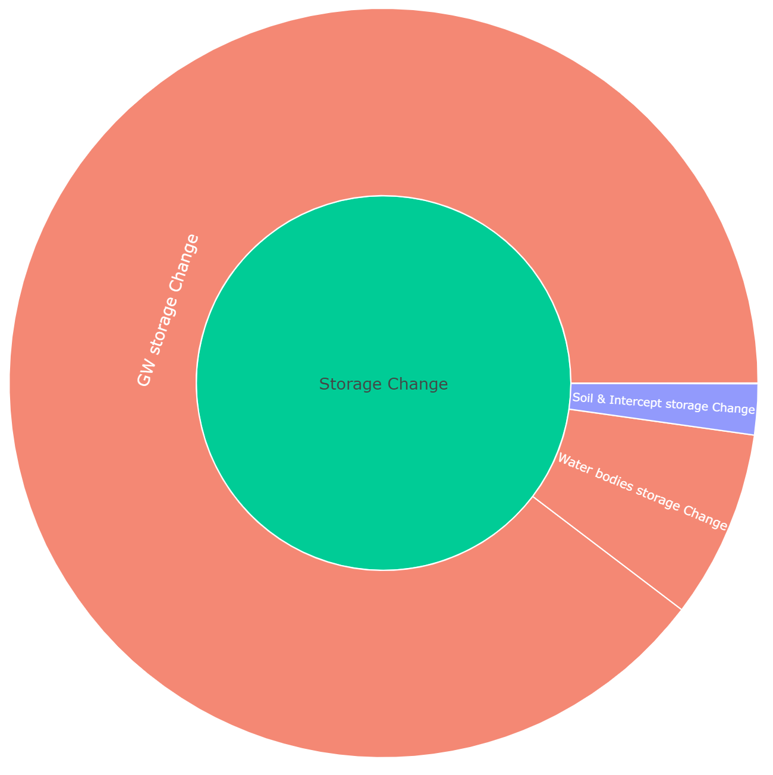

$$=\sum_{Storages}{\left|\text{Storage} \text{change}\right|}$$
STORAGE CHANGE

